Slide 1
Predicting Hospital Readmissions in Diabetic Patients
By: Sara Golestaneh, Crystal Chen
Notes:
In this presentation

Slide 2
Today’s Agenda
In today’s presentation, we will cover:
Introduction
Data Wrangling
EDA
The Problem of Unbalanced Data
Solutions:
Undersampling
Oversampling
Comparison of over- and under-sampling using cross-validation
Optimization
Conclusion
References
Notes:
In today’s presentation, we will go over the objectives of the project, data wrangling and an overview of the structure of the data. We will then look at a major issue in the data and our solutions as well as our results.

Slide 3

Introduction
Hospital readmission can be the result of a variety of factors. Lowering readmissions can help reduce healthcare costs, which is especially important in world where healthcare budgets are often being reduced.
Objective: Using binary classification to identify significant factors which lead to hospital readmissions. Note, we only considered readmissions under 30 days were considered as actual readmissions
Relevant dataset: Diabetes 130 US hospitals for years 1999-2008
Notes:
Hospital readmission can be due to a variety of factors. As such, lowering readmissions can not only help increase quality of care, lower the burden on healthcare staff and reduce costs, which is especially important in a world where healthcare budgets are consantly being slashed. So our objective was to identify factors which significantly impact rates of hospital readmission. The relevant dataset that we used was the Diabetes 130 US hospitals from 1999-2008.

Slide 4
Summary of Data Wrangling
For categorical variables:
Missing/unknown values were marked as ‘Unknown”/”Other”
Converted to one-hot encoding
Age: midpoints of each level were chosen to turn it into a numerical variable
Medical Specialty, Diagnosis 1-3: reduced the number of categories to top 10 most frequent categories & other
Notes:
Our data involved a combination of categorical and numerical data. For the categorical variables, any missing/unknown values were marked as “unknown”/”other” depending on the context. With the exception of age, they were all converted to have one-hot encoding. Meanwhile, we picked the midpoint of each age range as the estimate of the patient’s age. For medical specialties and diagnoses 1-3, we reduced the number of categories to only the top 10 most common categories and an “Other” category.

Slide 5
Summary of Data Wrangling
For numerical variables: no manipulations required
Dropped variables: Weight, 9 medication variables (acetohexamide, tolbutamide, troglitazone, examide, citoglipton, glipizide.metformin, glimepiride.pioglitazone metformin.rosiglitazone, metformin.pioglitazone)
Removed data points: patients who expired or transfered to hospices (ID: 11, 13, 14, 19, 20, 21) were removed.
Notes:
We didn’t have to do anything with the numerical variables as they were pretty clean. We dropped weight and 9 medications as they were either missing 90% of their data or had levels with very few datapoints. We also removed patients who expired or were transfered to hospices

Slide 6
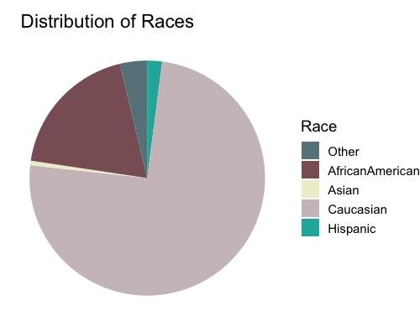
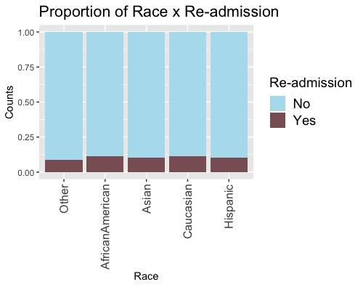
EDA - Race
Notes:
In our EDA, we wanted to explore factors that were linked to health and readimssion from an common sense standpoint. Firstly,, our dataset involves close to 75% Caucasian patients, followed closely by African Americans at 19%. But re-admittance rates across the races are similar, at around 10-11% for each race.

Slide 7
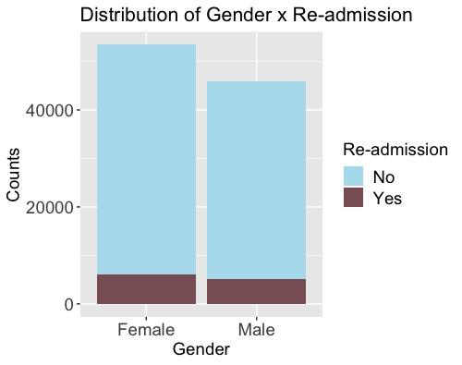
EDA - Gender
Notes:
Gender is more closely balanced with 54% females and readmittance rates are similar with females being readmitted 11.5% of the time while males being readmitted 11.3% of the time.

Slide 8
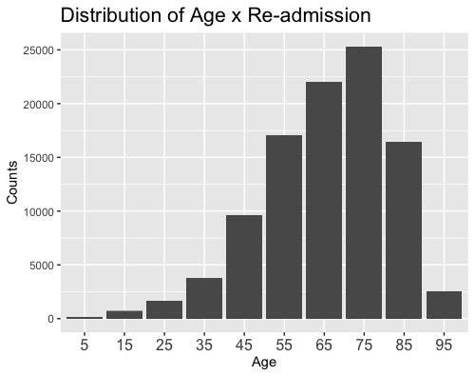
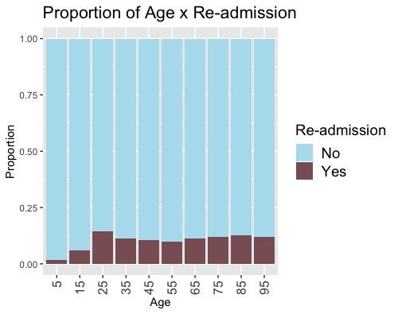
EDA - Age
Notes:
Unsurprisingly, most patients were between the ages of 55-85, when our health begins to decline, but interestinly we can see that the highest proportion of readmittance occurs in the 20-29 year cohort, with rates remaining relatively steady afterwards. So age may not be a good indicator of readmittance as we may believe.

Slide 9
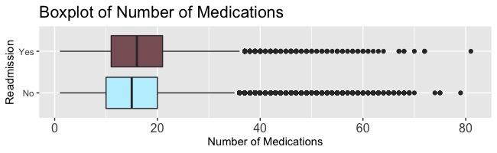
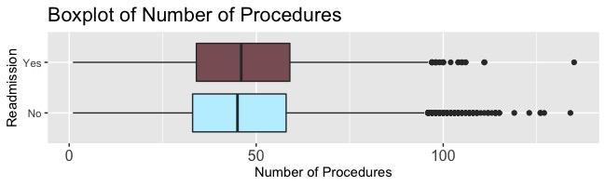
EDA - Procedures/Medications
Notes:
Surprisingly, the number of procedures that a patient undergoes (whether it is lab or other procedures) and the number of medications they take not necessarily indicators of readmission as we can see from their similar box plots.

Slide 10
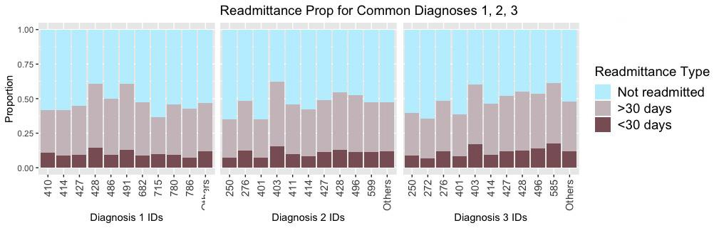
EDA - Diagnosis 1, 2, 3
Notes:
Looking at the most frequent IDs for diagnosis 1-3, we find readmission is higher in IDs 428 (heart failure) and 491 (chronic bronchitis) for diagnosis 1, 403 (hypertension renal disease) and 276 (disorders of fluid, electrolytes and acid-balance) in diagnosis 2, 403, 276 and 585 (chronic renal failure) in Diagnosis 3.

Slide 11
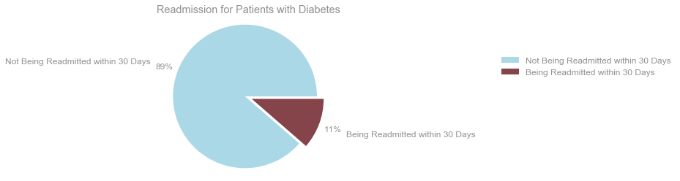
Imbalanced Dataset
Notes:
So as you may have noticed, the dataset is quite imbalanced in terms of pateitn demographics and even just hosptial readmissions. This presents a problem because this means we have more information about patients who were not readmissed and their details than patients who were readmissed. Given the goal is to predict readmissions, we really don’t want to be lacking information about readmitted patients.

Slide 12
Methods for Balancing out the Dataset
Undersampling the majority class (Random Undersampling)
Naive Random Oversampling
Oversampling the minority class:
Synthetic Minority Oversampling Technique (SMOTE)
Notes:
There are 2 main methods for classifying imbalanced dataset. Undersampling and oversampling. One way to undersample is just by simply random undersampling where we choose random number of data points from the majority class. Similarly in Oversampling we can randomly duplicate a number of datapoints in the minority class. However there is another method in oversampling which is called Smote and uses K-nearest neighbours and interpolates datapoints.Since random undersampling and random oversamplin results were similar we are going to focus on random undersampling and SMOTE in this presentation.

Slide 13
Models
LogisticRegression
RandomForestClassifier
GradientBoostingClassifier
XGBoostClassifier
Notes:
The models that we are going to evaluate are LogisticRegression (using L2 regularization), RandomForestClassifier
GradientBoostingClassifier XGBoostClassifier

Slide 14
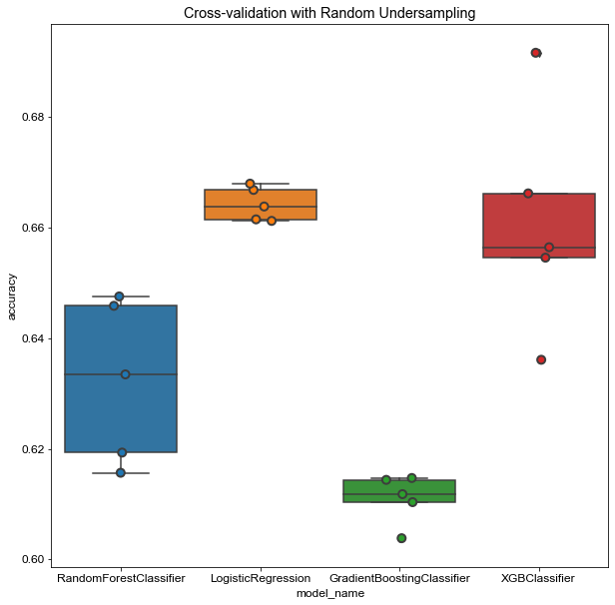
Cross-validation with Random Undersampling
Notes:
To evaluate the models using different techniques of balancing out the data we used cross validation (with 5 folds) and made sure that the undersampling or oversampling were done on the training partitions and not the validation partition. and as you can see in under sampling the top two models are XGBoost classifier and LogisticRegression classifier with an accuracy around 66.

Slide 15
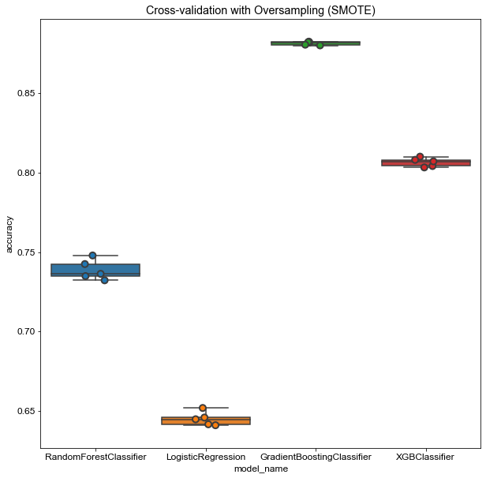
Cross-validation with SMOTE Oversampling
Notes:
In oversampling however the top two models were gradient boosting and XGBoost with a much higher accuracy around 85 and 80.

Slide 16
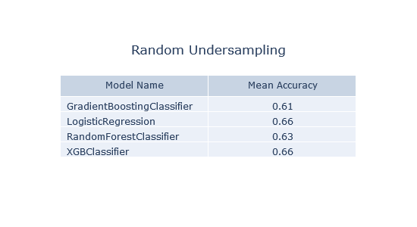
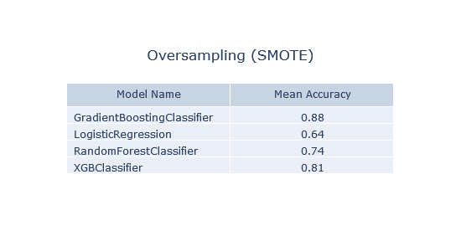
Oversampling VS Undersampling Mean Accuracies for each Model
Notes:
So just by comaparing the accuracies one might conclude that the oversampling method resulted in higher accuracies in general and therefore we use SMOTE instead of random undersampling.

Slide 17
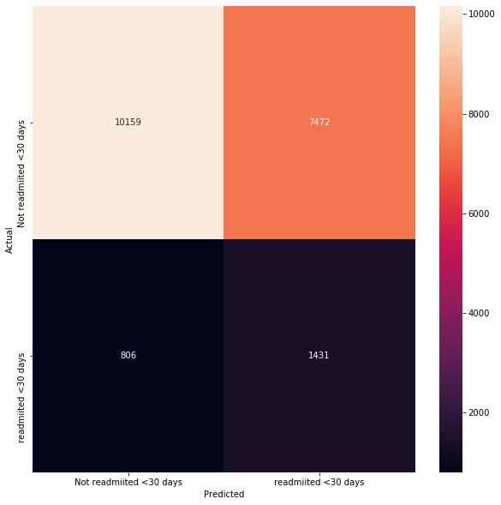
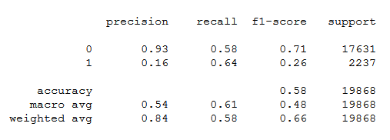
Random Undersampling Results for XGBoost
Notes:
But if we take a closer look for other metrics for random undersampling we can see that even though for example the accuracy is low the recall is aaround 64

Slide 18
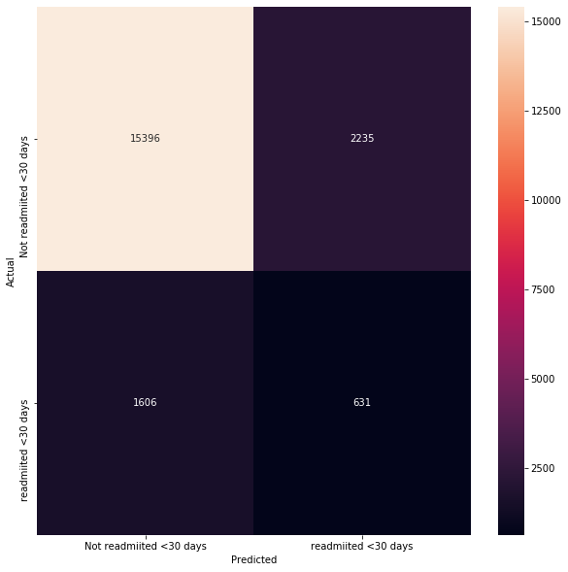
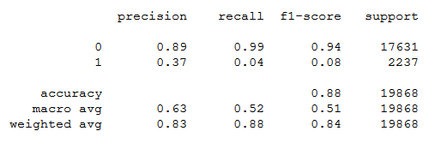
SMOTE Oversampling Results for XGBoost
Notes:
However in SMOTE while the accuracy of XGboost is 88 the recall is almost 0. This shows that SMOTE method results in more conservative models where they prefer tp label as few positive classes as possible. So to select the best model it depends what is more important for us. We decided that in our case, since we want to detect as many as readmissions as possible recall of the positive class is more important. So we chose random oversampling.

Slide 19
Hyperparameter Tuning
Using Grid Search
K-fold Cross-validation
Focused on AUC as the metric to optimize
Notes:
The main problem in random under sampling however was the large number of false positives, so after choosing the model with the high recall we decided to optimize the model using AUC metric to account for false positives as well. We did the hyperparameter using cross validation and grid search.

Slide 20
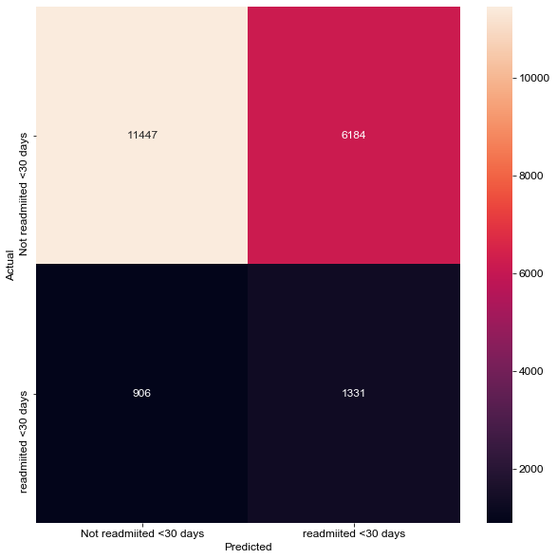
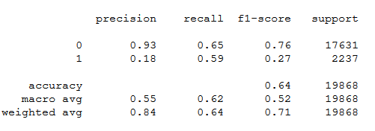
Final Model (XGBoost) after Optimizing
Notes:
So as you can see the number of false positives decreased after optimizing and our final mode has an accuracy of 64 and a recall of 59.

Slide 21
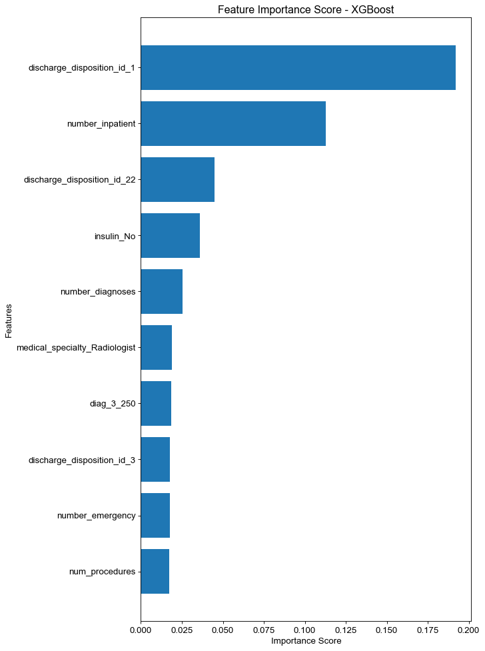
Top 10 Features
Discharged to Home
Number of inpatient visits in the year
Discharged/transferred to another rehab
No insulin prescribed
Number of diagnoses
Medical specialty: Radiologist
Diabetes Mellitus as third diagnosis
Discharged/Transferred to Skilled Nursing Facility
Number of emergency visits
Number of procedures
Notes:
Here are the top 10 features based on their weights (number of times they were used in decision trees). Some interesting features to note are no insulin prescription, Diabetes Mellitus as third diagnosis significantly impact readmission rates. Perhaps diagnosing diabetes early on and prescribing insulin lower readmission rates as patients do not have to revisit the hospital to address their health issues.

Slide 22
Conclusion
Preprocessing was the most important step
Random undersampling was much faster and showed better results (in terms of recall) for balancing out the data
On held out test data, our best model had an AUC of of 0.62
Using our model, we are able to catch 59% of the readmissions within 30 days and correctly classify 64% of all patients

Slide 23
Reference
Discharge Disposition and Admission IDs. Data World. URL: https://data.world/uci/diabetes-130-us-hospitals-for-years-1999-2008
Predicting Hospital Readmissions for Patients with Diabetes Using Scikit-Learn. Towards Data Science. URL: https://towardsdatascience.com/predicting-hospital-readmission-for-patients-with-diabetes-using-scikit-learn-a2e359b15f0
List of ICD-9 Codes. Wikipedia. URL: https://en.wikipedia.org/wiki/List_of_ICD-9_codes

Slide 24
Questions?
Notes:
In this presentation

